Slide 1

Inconsistencies among
spectral robustness metrics
Robert Kooij
In honor of the 75th birthday of Dragoš Cvetković

Slide 2




Jasmina Omić
Miroslav Živković

Slide 4
Robustness

Slide 5
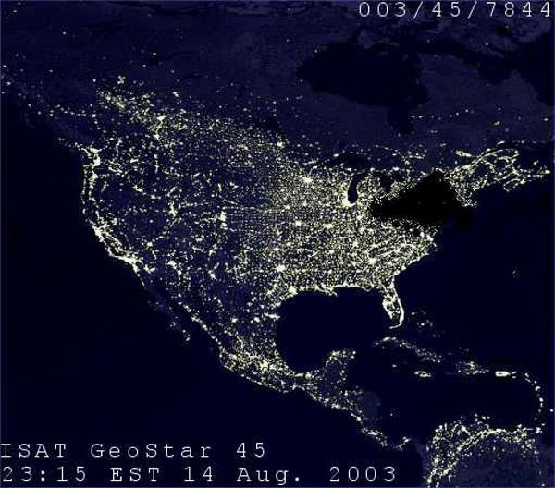

Slide 6
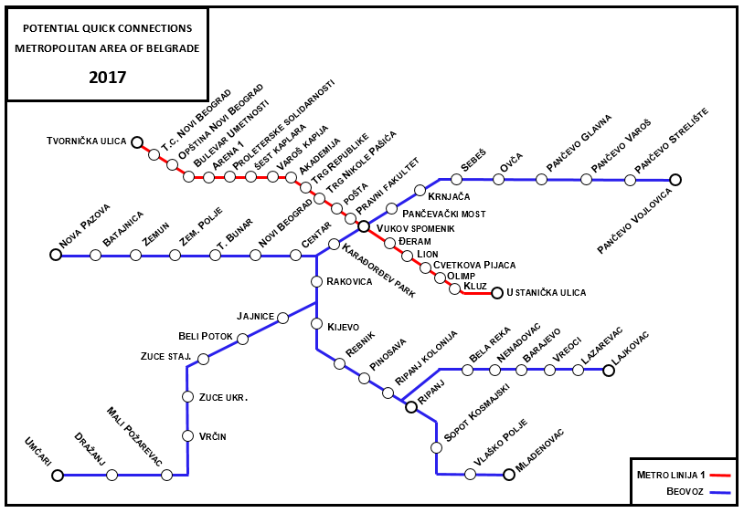

Slide 7


Slide 8
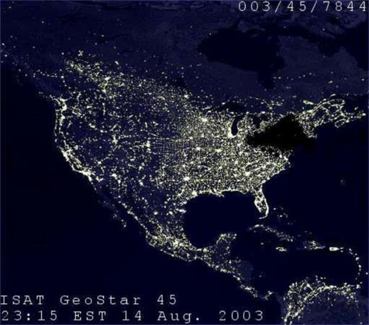



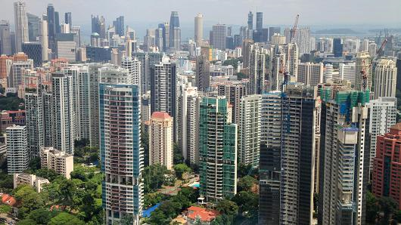

Robustness is a grand challenge

Slide 9
Quantify Robustness Through
Spectral Graph Metrics
Example: algebraic connectivity
  Second smallest eigenvalue of Laplacian matrix (μ_{N-1})
G₁
μ_{N-1}(G₁) = 0
G₂
μ_{N-1}(G₁) = 0.29
G₃
μ_{N-1}(G₁) = 0.59

Slide 10

Quantify Robustness Through
Spectral Graph Metrics
Spread of malware (malicious software)
Infection rate per link: β
Curing rate per node: δ
s=β/δ: effective spreading rate

Slide 11


Epidemic threshold s_{c}
Effective spreading rate ≤ s_{c} → malware dies out
Effective spreading rate > s_{c} → malware survives
$$s_{c}=\frac{1}{spectral radius}$$
spectral radius = largest eigenvalue adjacency matrix

Slide 12
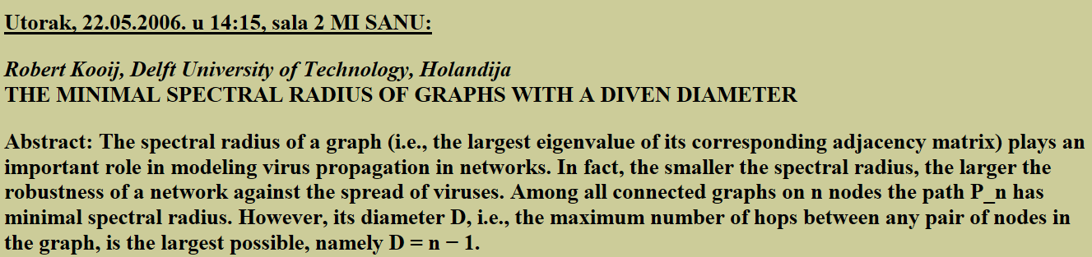
A. Jamakovic, R.E. Kooij, P. Van Mieghem and E.R. van Dam, Robustness of networks against the spread of viruses: the role of the spectral radius, Proc. of the 13th Annual Symp. of the IEEE/CVT Benelux, Liége, Belgium, 23-11-2006.

Slide 16
Comparing Robustness Metrics
Edge connectivity
1
2
Algebraic connectivity
0.634
0.586

Slide 17
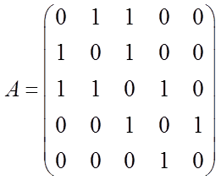
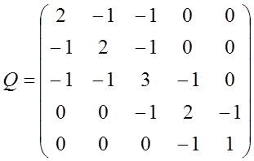
Spectral Robustness Metrics
spectral radius
algebraic connectivity
spectral gap
# of spanning trees
natural connectivity
effective graph resistance
min-max ratio
eigenvalue ratio

Slide 18
Considered graphs
G1
G2
G3
G4
G5
G6
G7
G8
G9
G10

Slide 19
Inconsistencies
43% of inconsistencies found through G1:G2

Slide 20
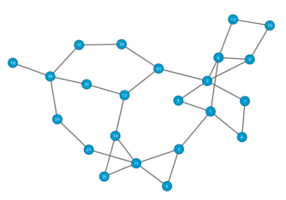
Real-world networks
ABOVEnet
AGIS
ATMnet
BBNplanet
BIZnet
BT_Europe
http://www.topology-zoo.org/

Slide 22

Future work
Implications for design
Consider more robustness metrics
Linear combinations of metrics
Deal with graphs of different size

